Slide 1

What is AI – Part 3

Slide 2
How do machines learn?
Notes:
Here’s our essential question for today’s class. Please keep this question in mind as we work through today’s presentation and activities.

Slide 3
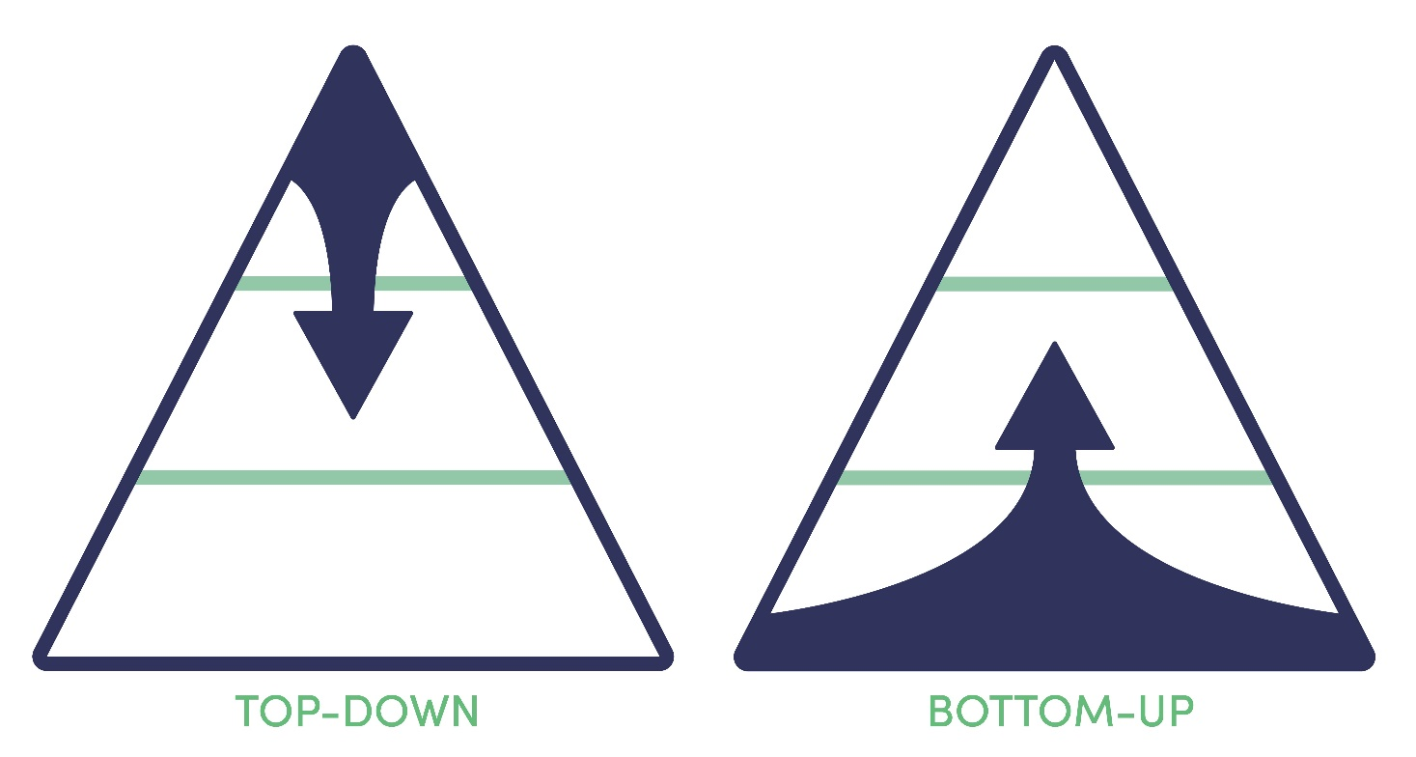
Notes:
Interestingly, the major computational approaches to AI were all established from the 1950’s to the 1970’s, and they can be grouped into two basic categories. Top-down and Bottom-up methods.

Slide 4

Notes:
Let’s consider the top-down approaches first, with the following characteristics:
Focus on knowledge, problem decomposition, symbolic (abstract) reasoning, and problem-solving algorithms.
AI achieved by direct engineering.
… and here’s a couple examples.

Slide 5
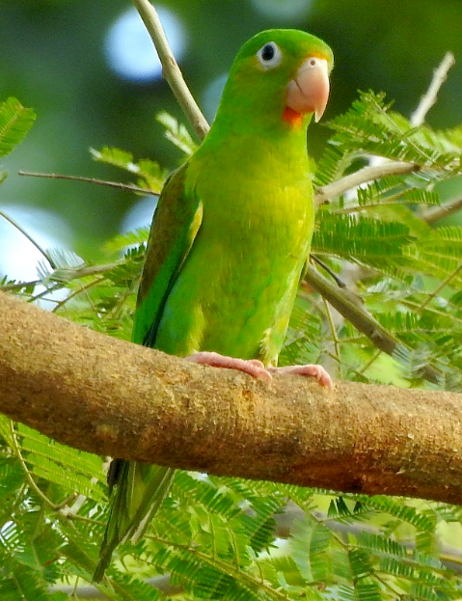
Can the orange-chinned parakeet fly?
Laura Gaudette (CC-BY)
Knowledge base
Birds can fly (0.99).
A parrot is a bird.
The orange-chinned parakeet is a parrot.
…
Q: Can the orange-chinned parakeet fly?
Inference Engine
A: The orange-chinned parakeet most likely can fly.
Notes:
In our first example, we want to ask an expert system a question.
Can the orange-chinned parakeet fly?
To answer that question, we first model our knowledge in a knowledge base, consisting of a set of interconnected propositions, also called heuristics or rules of thumb.
At the heart of our expert system lies an inference engine capable of applying logical rules to our knowledge base to deduce new information.
We then present our question to the inference engine – “Can the orange-chinned parakeet fly”
The inference engine, in turn, queries the knowledge base, and uses its internal logic to…
… respond with an answer.
Expert systems were popular in the late 1980’s, with most systems being developed in Lisp or Prolog.

Slide 6
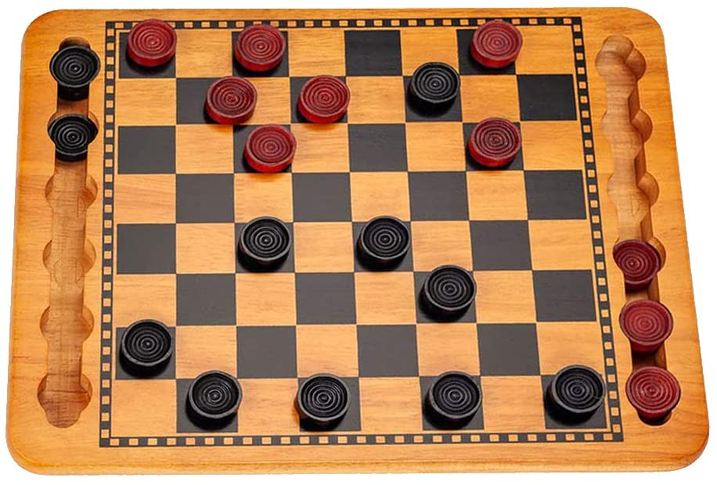
What is red's next move?
Game tree search
next move
Game board representation
Position evaluator
Rule-based pruning
Notes:
In our second example, we’ll take a look at an AI system capable of playing checkers.
In this case, we want to determine red’s next move (the AI system is playing red).
To figure that out, the game state and position of each piece is modelled in a data structure called the game board representation.
… that game board representation is fed to a position evaluator…
as well as the game tree search algorithm which, in turn…
queries the position evaluator.
Prunes the search tree
And responds with a move.
Search is a big deal in AI and will continue to be so into the indefinite future.
However, the idea of intelligent machines capable of playing games is not new. In 1959, Arthur Samuel created a system capable of playing checkers. The main driver of the machine was a search tree of the board positions reachable from the current state. Since he had a very limited amount of available computer memory, Samuel implemented what is now called alpha-beta pruning. Instead of searching each path until it came to the game's conclusion, Samuel developed a scoring function based on the position of the board at any given time.

Slide 7
Top-Down (Summary)
Notes:
These two examples of the top-down approach to AI can be summarized as follows:
Focus on knowledge representation, problem decomposition, symbolic reasoning, and problem-solving algorithms.
These are examples of “common sense” reasoning – playing checkers, arriving at conclusions, given a set of propositions.
Deductive logic – if the premises are true, the conclusion follows
All men are mortal – Socrates is a man – Therefore Socrates is mortal
AI is achieved through direct engineering w/Prolog or LISP

Slide 8

Notes:
And now for the bottom-up approach to AI. A couple distinguishing features of bottom-up approaches to AI are as follows:
Focus on inputs (e.g., data, environment) and low-level methods of processing.
AI achieved by learning, self-organization, or optimization.

Slide 9


Cat or Dog?
Mathematical function mapping image to label (“cat” or “dog”)
cat
Notes:
Our bottom-up example is a simple classification task – Is this an image of a dog or a cat?
We start with a mathematical function capable of mapping an image to its corresponding label.
We then present the function with an image and it, in turn, responds
with a prediction – that this image is a cat.

Slide 10

Cat or Dog?
Mathematical function mapping image to label (“cat” or “dog”)
E.g.: y = mx + b
Special numerical values in the function are “knobs” we can turn to adjust the outputs.
Notes:
Okay – let’s clear the decks and take another look at our function.
First, we add a set of knobs which, in turn,
… allow us to adjust the way the function operates, including its outputs.
Here’s an example function
… with a couple adjustable parameters.

Slide 11
Cat or Dog?
Mathematical function mapping image to label (“cat” or “dog”)
Notes:
Let’s reset and step through a concrete example of the training process. In the field of AI, the mathematical function is often called the model and the knobs are parameters or hyperparameters, depending on the scope of control. A parameter is internal to the model whereas a hyperparameter (for example, the learning rate) is external, set directly when the model is defined.

Slide 12
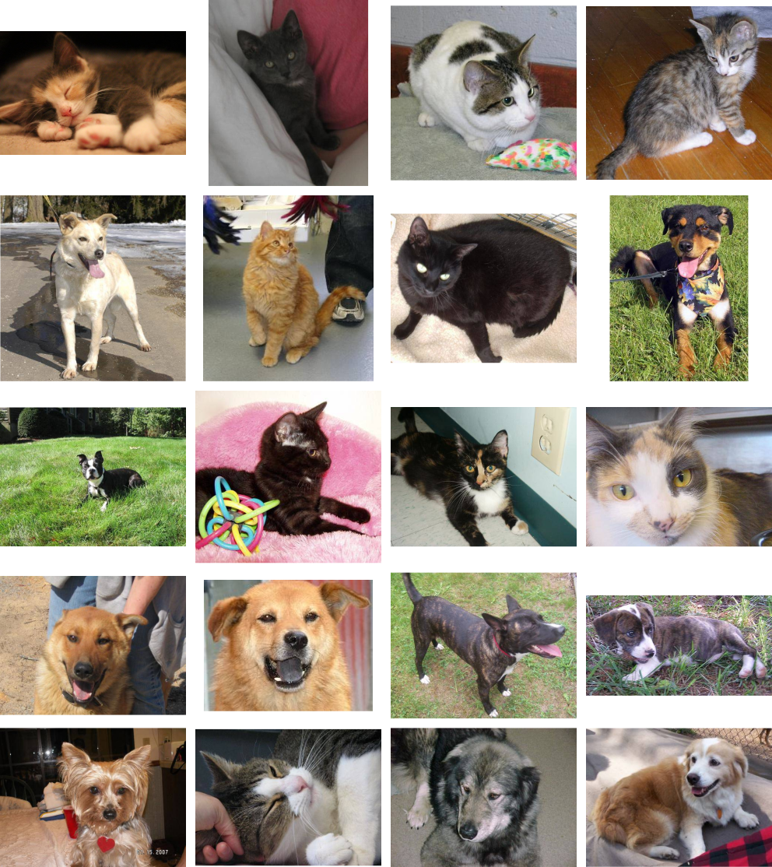
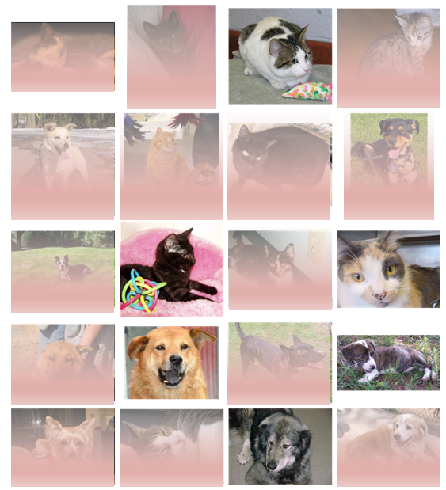

Cat or Dog?
Mathematical function mapping image to label (“cat” or “dog”)
Training algorithm
Notes:
The training process begins by initializing our parameters to random values.
A set of images is fed to the function with a ‘dog’ or ‘cat’ label attached to each. The function then classifies the image – this is a ‘dog’ or this is a ‘cat’.
As we can see, most of the predictions are wrong in this initial training iteration (epoch), with the images in red being incorrectly classified.
This performance information is then sent back to the training algorithm.

Slide 13

Cat or Dog?
Mathematical function mapping image to label (“cat” or “dog”)
Training algorithm
Notes:
.. which adjusts the knobs.

Slide 14
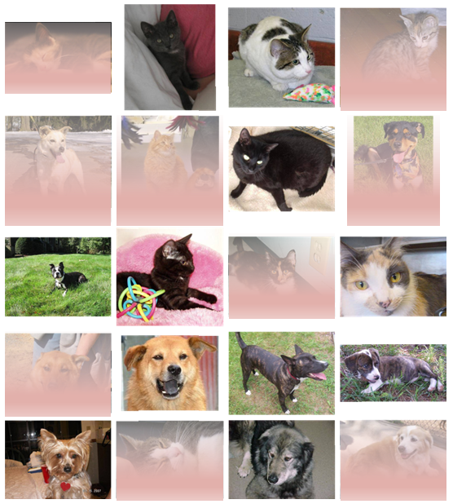
Cat or Dog?
Mathematical function mapping image to label (“cat” or “dog”)
Training algorithm
Notes:
… and we start the process again.
The cat and dog images are fed to the function.
The function classifies the images. It appears that we’re headed in the right direction as more of the dog and cat images are correctly classified. We have fewer mistakes, indicated by the red shading.
Performance feedback is once again sent to the training algorithm
… which controls the knobs.

Slide 15

Cat or Dog?
Mathematical function mapping image to label (“cat” or “dog”)
Training algorithm
Notes:
… which adjusts the knobs.

Slide 16
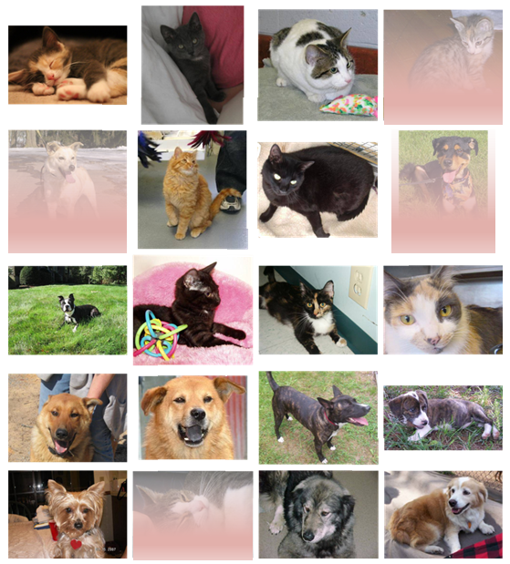
Cat or Dog?
Mathematical function mapping image to label (“cat” or “dog”)
Training algorithm
Notes:
… and we start the process again.
The cat and dog images are fed to the function.
It looks like our training algorithm has done a good job adjusting the model’s parameters, especially when we compare the images correctly classified in the first training round (called an epoch in AI) with those correctly classified in this round. Most of the images are now correctly classified. In practice, we might continue to train the model, with a desire to improve performance even more.
Performance feedback is once again sent to the training algorithm
… which controls the knobs. At this point, we could continue to train the model, with a desire to improve performance even more. But at some point, we arrive at a point where it’s as good as it will ever get, and further training becomes pointless.

Slide 17
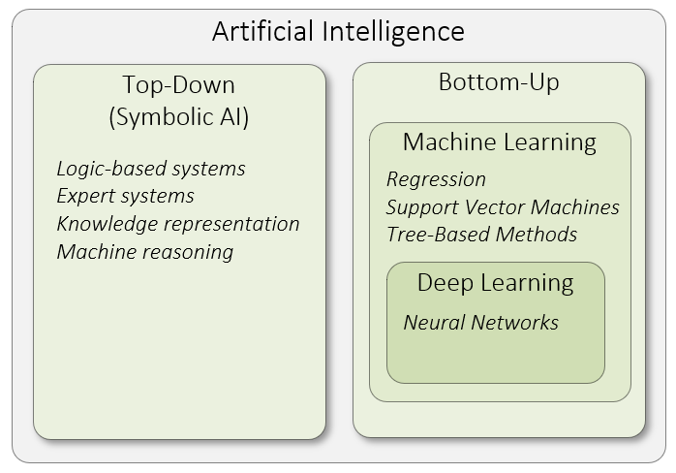
Notes:
Two approaches – top-down vs. bottom-up
Top-down (symbolic) AI systems do not learn – knowledge modelling – 1980s / 1990s – heuristics / rules of thumb – Prolog or Lisp
Machine learning uses statistical methods to enable computer systems to learn from data.
Deep learning focuses on neural networks.
=====
Okay – let’s summarize what we’ve covered so far. As pictured here, AI is a broad field of study with two distinct approaches to intelligence. Within the bottom-up approach, deep learning has emerged as a sub-field of machine learning within the past decade.
Keep in mind that top-down or symbolic AI systems do not learn. In other words, all the knowledge the system needs to function is built into the system upfront. That was certainly the case with the expert systems in the 1980’s. Knowledge was typically represented as rules of thumb in these systems, otherwise known as heuristics. At that time, most AI work was done in the Prolog or Lisp programming languages.
So, artificial intelligence (AI) is the overarching discipline that concerns itself with the development of computer systems capable of performing tasks that humans are good at; for example, recognizing objects, making sense of speech, and decision making in a constrained environment.
Machine learning is the field of AI that applies statistical methods to enable computer systems to learn from data to achieve an end goal.
And finally, deep learning is a field of machine learning which focuses on neural networks. A neural network is a special type of learning algorithm, inspired by the billions of interconnected neurons in the human brain.

Slide 18


Notes:
Source: Google Teachable Machine: https://teachablemachine.withgoogle.com
Two Locations for the Hanfu/Hanbok dataset
https://drive.google.com/file/d/1q3RIgIoeePNW-fEgNyCgh45gBvMAdeOU/view
https://drive.google.com/file/d/1WbZPzunh6u9f0leymbzmVrJjSxq6JW5w/view?usp=sharing

Slide 19

Questions
Notes:
Any questions?

Slide 21



Multi-Select Multiple Choice
Single Answer Multiple Choice
Word Cloud

Slide 22
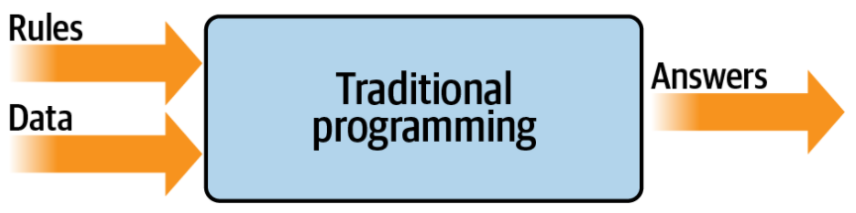
Source: Moroney, L. (2021). AI and Machine Learning for Coders: A Programmer’s Guide to Artificial Intelligence. Sebastopol, CA: O'Reilly Media, Inc. (Chapter 9)
Notes:
Now that we’ve considered both top-down and bottom-up approaches to AI, let’s view AI from third perspective – that of programming. Don’t worry, we don’t expect you to write any code in this class! In traditional programming, rules are expressed in a programming language. Those rules, in turn, act on data and out come answers.
The model pictured here has been the backbone of development since its inception. But it has an inherent limitation: namely, that only scenarios that can be implemented are ones for which you can derive rules. What about other scenarios? Usually, they are infeasible to develop because the code is too complex. It’s just not possible to write code to handle them.
Let’s consider a concrete example…

Slide 23
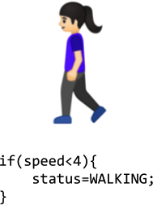
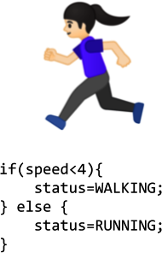
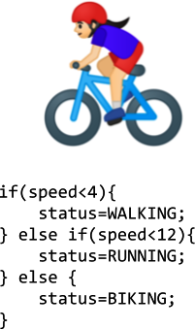

Source: Moroney, L. (2021). AI and Machine Learning for Coders: A Programmer’s Guide to Artificial Intelligence. Sebastopol, CA: O'Reilly Media, Inc. (Chapter 9)
Notes:
Take, for example, activity detection. Fitness monitors that can detect our activity are a recent innovation, not just because of the availability of cheap and small hardware, but also because the algorithms to handle detection weren’t previously feasible. Let’s explore why.
In the first case, we see a naive activity detection algorithm for walking. It can consider the person’s speed. If it’s less than a particular value, we can determine that they are probably walking. Given that our data is speed, we could extend this to detect if they are running, as in the 2nd case.
As you can see, going by the speed, we might say if it is less than a particular value (say, 4 mph) the person is walking, and otherwise they are running. It still sort of works. Now suppose we want to extend this to another popular fitness activity, biking. The algorithm might look like that in the 3rd case.. I know it’s naive in that it just detects speed—some people run faster than others, and you might run downhill faster than you cycle uphill, for example. But on the whole, it still works.
However, what happens if we want to implement another scenario, such as golfing, in case #4?
We’re now stuck. How do we determine that someone is golfing using this methodology? The person might walk for a bit, stop, do some activity, walk for a bit more, stop, etc. But how can we tell this is golf? Our ability to detect this activity using traditional rules has hit a wall. But maybe there’s a better way.
Enter machine learning.

Slide 24
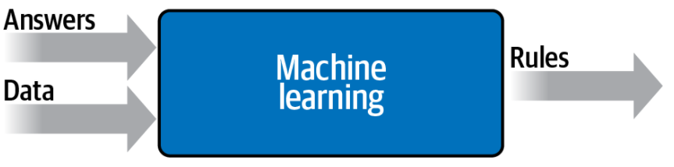
Source: Moroney, L. (2021). AI and Machine Learning for Coders: A Programmer’s Guide to Artificial Intelligence. Sebastopol, CA: O'Reilly Media, Inc. (Chapter 9)
Notes:
Let’s take another look at the diagram we used to demonstrate what traditional programming is. Here we have rules that act on data and give us answers. In our activity detection scenario, the data was the speed at which the person was moving; from that we could write rules to detect their activity, be it walking, biking, or running. We hit a wall when it came to golfing, because we couldn’t come up with rules to determine what that activity looks like.
But what would happen if we were to flip the axes around on this diagram? Instead of coming up with the rules, what if we were to come up with the answers, and along with the data have a way of figuring out what the rules might be? The bottom image shows what this would look like. We can consider this high-level diagram to define machine learning.
So, what are the implications of this? Well, now instead of us trying to figure out what the rules are, we get lots of data about our scenario, we label that data, and the computer can figure out what the rules are that make one piece of data match a particular label and another piece of data match a different label.

Slide 25
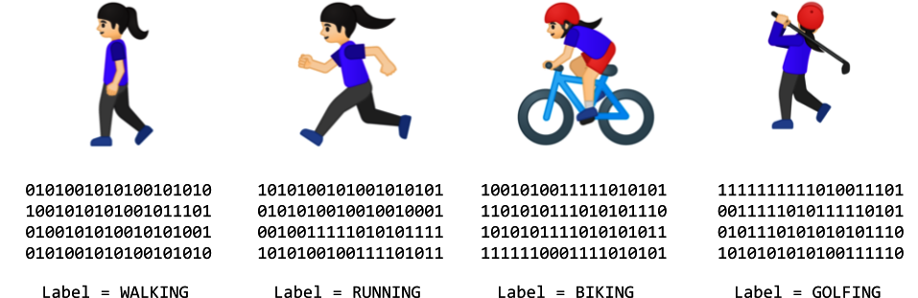
Source: Moroney, L. (2021). AI and Machine Learning for Coders: A Programmer’s Guide to Artificial Intelligence. Sebastopol, CA: O'Reilly Media, Inc. (Chapter 9)
Notes:
How would this work for our activity detection scenario? Well, we can look at all the sensors that give us data about this person. If they have a wearable that detects information such as heart rate, location, speed, etc.—and if we collect a lot of instances of this data while they’re doing different activities—we end up with a scenario of having data that says, “This is what walking looks like,” “This is what running looks like,” and so on. Now our job changes from figuring out the rules to creating the machine learning models that can match the data to the labels.

